Slide 1


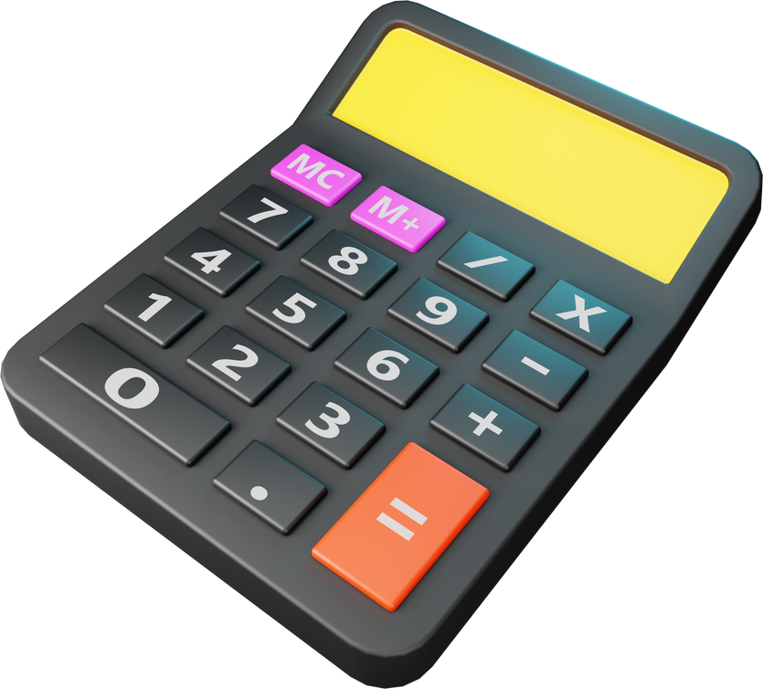
SILIGURI INSTITUTE OF TECHNOLOGY
BACHELORS IN COMPUTER APPLICATION
PYTHON PROGRAMMING
TOPIC- CALCULATOR
Presentation by
Project Group B

Slide 2
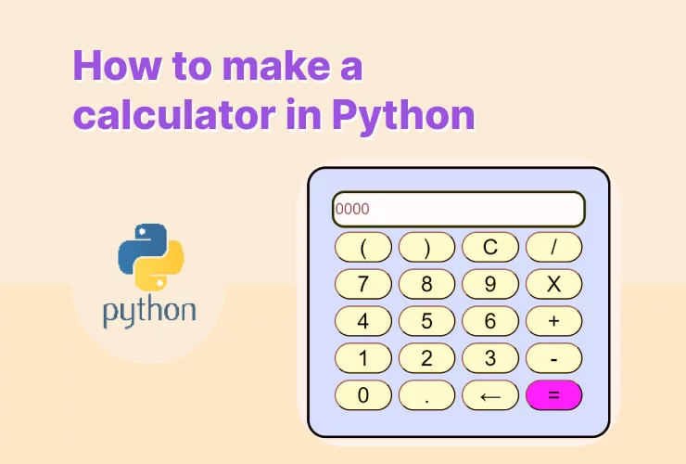
Introduction
WE FROM THE BB GROUP WILL PRESENT AN ASSIGNMENT ON HOW TO MAKE A CALCULATOR USING PYTHON
Group B
1

Slide 3
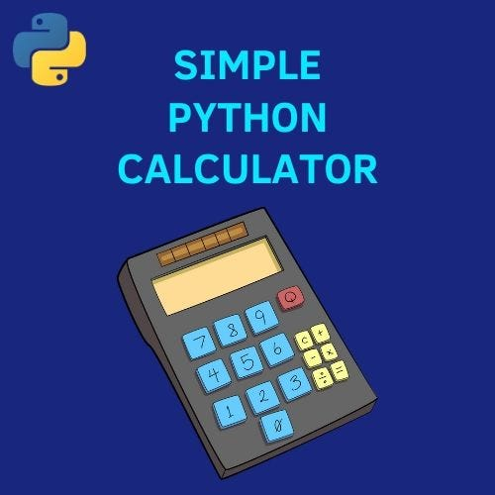
Our Team
DIPTANIL DUTTA
JISU PANDIT
SUBHOJEET GHOSH
DIPU DEBSHARMA
ARIJIT SINGHA
KULDEEP DEBNATH
Group B
3

Slide 4
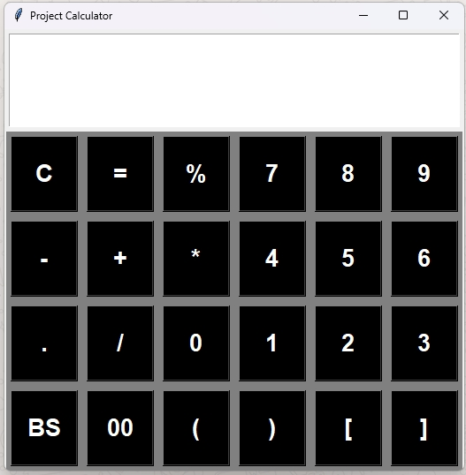
Application
This code represents a basic calculator
GUI application using the Tkinter library in
Python. The calculator has a graphical
interface with buttons for digits,
operators, and control functions. It allows
users to perform arithmetic operations
and provides functionalities like clearing
the screen, backspacing, and evaluating
expressions.
Group B
4

Slide 5
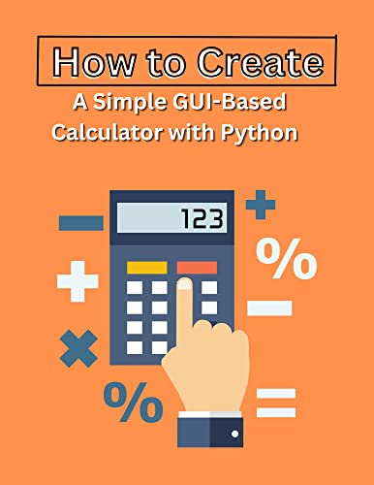
Application Benefits
USER INTERFACE: UTILIZES TKINTER TO CREATE A GRAPHICAL INTERFACE WITH A LARGE ENTRY SCREEN FOR DISPLAYING INPUT AND RESULTS.
INPUT HANDLING: CAPTURES BUTTON CLICKS USING THE <BUTTON-1> EVENT AND PROCESSES THE CORRESPONDING ACTION BASED ON THE CLICKED BUTTON.
EXPRESSION EVALUATION: SUPPORTS BASIC ARITHMETIC OPERATIONS (+, -, *, /), PARENTHESES, PERCENTAGE, AND DOUBLE ZEROS.
DYNAMIC DISPLAY: UPDATES THE SCREEN IN REAL-TIME AS USERS INPUT VALUES OR PERFORM OPERATIONS.
CLEAR AND BACKSPACE: PROVIDES A CLEAR BUTTON ("C") TO RESET THE CALCULATOR AND A BACKSPACE BUTTON ("BS") TO DELETE THE LAST ENTERED CHARACTER.
Group B
6

Slide 6

Application Benefits
ERROR HANDLING: CHECKS IF THE ENTERED VALUE IS A DIGIT BEFORE EVALUATION TO PREVENT ERRORS.
RESIZABLE GUI: SETS A FIXED SIZE FOR THE CALCULATOR WINDOW TO MAINTAIN A CONSISTENT LAYOUT.
STYLING: APPLIES A CONSISTENT STYLE TO THE BUTTONS USING A BOLD LUCIDA FONT, WHITE TEXT ON A BLACK BACKGROUND FOR BETTER VISIBILITY.
ORGANIZATION: ARRANGES BUTTONS IN ROWS AND PACKS THEM INTO FRAMES FOR A NEAT AND ORGANIZED LAYOUT.
LIMITATIONS: THE CODE MIGHT NEED ADDITIONAL ERROR HANDLING FOR MORE COMPLEX SCENARIOS, AND IT CURRENTLY LACKS SUPPORT FOR ADVANCED MATHEMATICAL FUNCTIONS.
Group B
6

Slide 7
CONCLUSION
IN CONCLUSION, OUR CALCULATOR PROJECT AIMS TO PROVIDE USERS WITH A COMPREHENSIVE TOOL FOR MATHEMATICAL COMPUTATIONS.
WE BELIEVE THAT THE COMBINATION OF INTUITIVE DESIGN, ROBUST FEATURES, AND RELIABLE PERFORMANCE WILL MAKE OUR CALCULATOR A VALUABLE ASSET FOR STUDENTS, PROFESSIONALS, AND ANYONE IN NEED OF MATHEMATICAL ASSISTANCE.
THANK YOU FOR YOUR ATTENTION. WE WELCOME ANY QUESTIONS OR FEEDBACK
Group B
9

Slide 8


